Slide 1
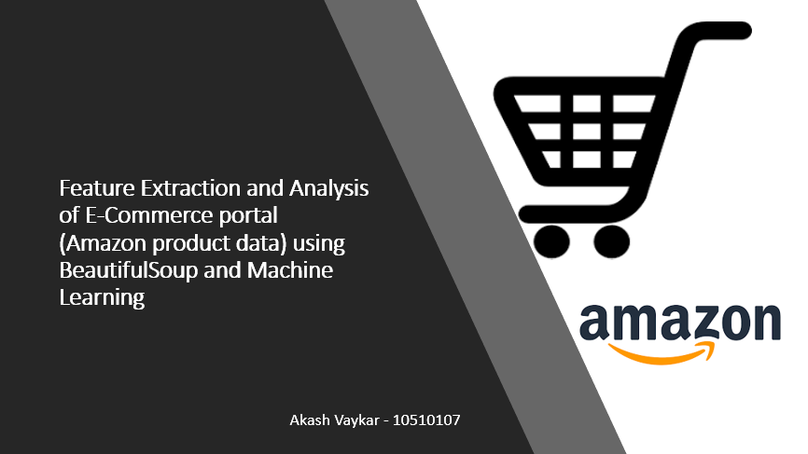

Slide 2






Target Data
E-Commerce
Amazon.com
Crawling, Extraction
Features
Extraction
Analysis Inferences, Statistics & ML Inferences
Advancements
Future works
Feature Extraction and Analysis of E-Commerce portal
(Amazon product data) using BeautifulSoup and Machine Learning

Slide 3

Introduction and Background
People are internet savvy. Everything is in data in E-commerce websites about product information, price details, technical specifications, product reviews etc. and Shopping online is became very popular nowadays.
Ever wondered, when everything is on web with too much information, internet users have more often come across information that are not relevant for their use. Understanding and Exploring product that includes prices and reviews information before purchasing is too difficult when there are many sellers on same platform.
It is due lot of information and systems recommendations that encourages new sellers to propose their products on websites. With its unique play role of business, it is obvious that customer fail to get quality and right price of product. Which leads to customer Unsatisfaction with numerous reasons. This research aims to propose new insight views of same product though with numerous sellers. With respect to reviews, sellers service, product prices, return policies and etc.. identifying key aspects and recommending better seller with quality products to customer will impact on better service to existing platform.

Slide 4
Literature Review
The digital technological innovation has been recognized as one essential aspect of the E-commerce businesses comprehensive solution to improve the experience, productivity, recommendations, security and service-oriented outcomes of online shopping. Examples that include but not limited to, bad experience with product quality, price comparisons with respect to other sellers, Inadequate information of product details, product returns or cancellation terms and etc. all impacts on customer satisfaction. This project aims to provide better initiative sense of understanding all factors and improving customer satisfaction with respect to product prices, comparisons, reviews etc.
Most of internet data is unstructured and sometimes hard to interpret data that is scraped. Lots of regex and scraping techniques will have to be used to crawl, fetch and structure it. Recent or past researchers introduced different methodologies (like Jsoup, java library) to scrap web data and process information for Structural data.

Slide 5
Cont…
We are presenting a new way to crawl, extract information and analysis of E-commerce (Amazon) product big data with numerous features. Based on website structure and securities, crawl bot detects data with limited content and that used subjectively for analytical purposes.
Several python libraries like urllib.request, urllib.parse, urllib.error, Beautifulsoup, ssl certificates and scrapy and etc. helps to extract data with different formats. Expected file formats would be json, csv, xml, html or text.
Using Machine Learning methodology, prices inferences and Opinion mining(Sentimental Analysis) will be performed to key insights of product.
Lastly all results will be shown comparatively of chosen products that recognizes and attract users to place orders and new learn to seller at same time.

Slide 6




Methodological Directions
Product Details & Data Reviews
AMAZON
API
Connecting, Capturing and Cleaning
Crawling, extracting and scraping
Harnessing Social Data using Python libraries like Beautifulsoup, scrapy, urllib.request
Scraping, Extracting, Processing
pandas, numpy and scipy
Python
Data Analytics
Predictions (Regression Analysis and Sentiment Analysis)
Supervised Learning Method
Algorithms used
SVM Naive Bays
RNN
Maximum Entropy
Inferences
Statistics & Machine Learning
Advancements
Future Work
New Insight Views comparatively and its Directions

Slide 7
Tools
Python Web Scraping : Beautiful Soup, Urllib.request, Scrapy
Processing and Cleaning : Data-Science libraries include pandas, numpy, scipy
Data Source : Amazon.com (USA)
Sample Link : https://www.amazon.com/s?k=smartphones&ref=nb_sb_noss_2
Dataset size : 100,000+ (rows)
Dataset visualization : Tableau
Inferences and Predictions: Statistics, Sentimental Analysis (Fine-grained and Aspect-based Sentimental Analysis) using Machine Learning, Regression analysis for inferences about product prices and other parameters.

Slide 8
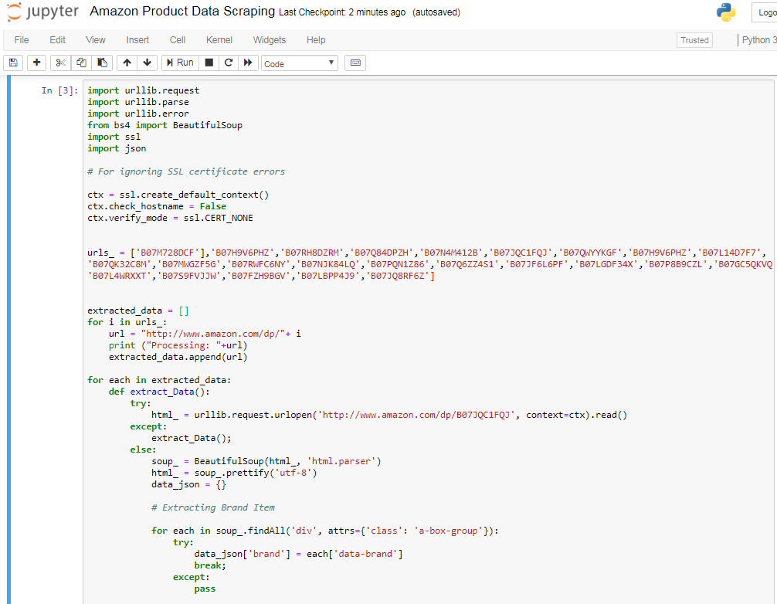
Sample code

Slide 9
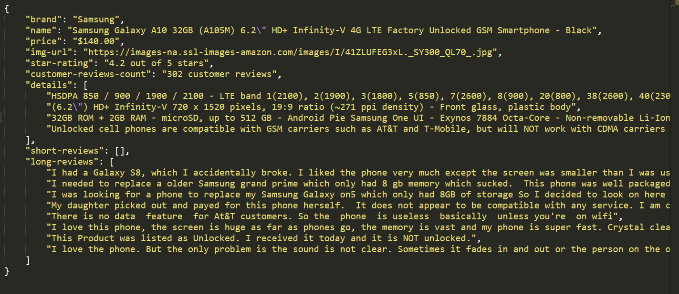
Sample Scraped data (Target Variables)

Slide 10
Flow Chart
Crawling Amazon Products pages
Use Python Data Science Libraries to extract data from Json file and make structure data
Pre-processing, Cleaning dataset
Collect ASIN (Amazon Standard Identification Number) using tools
Data Munging and Transformations using conversions and Groupby, apply functions
Fine-grained, Aspect-based Sentimental analysis
Using Statistical methodologies to find Product prices affects and current trends (Regression analysis)
Python code to scrap all data into json format
Sentence and Sub-sentence level
Product reviews will be critically examined using Sentimental Analysis (Machine Learning Algorithm)
Loop to get requested data
Comparative analysis will be done by advance plotting and examine key issues and benefits.

Slide 11
Research & Possible Findings
With this research, findings shows clear identification of product details comparatively with good quality, prices, reviews and with overall rating of a seller recommendations to customers.
New insight views can be introduced by keeping in mind both platform and customer benefit, so that System influences more purchases with good confidence level.

Slide 12

Future Works
Future work may include…
a) Users intention and experiences can be identified and propose new recommendations from system
b) Continuous enhancements leads to new representation of E-commerce site for better experience
c) Balance between customer and sellers’ delights (with proper guidelines) which in result of enriching businesses.

Slide 13
References
D. Rahul, S. Mrudav, P. Priyanka and P. Bhagirath."A Novel Approach to Web Scraping Technology,"International Journal of Advanced Research in Computer Science and Software Engineering, vol. 5, Issue. 5, 2015.
A. Pratiksha, S.R. Tandan, T. Priyanka and M. Rohit."Web Information Retrieval Using Python and BeautifulSoup,"International Journal for Research in Applied Science & Engineering Technology (IJRASET). vol. 4, Issue VI, 2016.
Sung-min Kim and Young-guk Ha, "Automated discovery of small business domain knowledge using web crawling and data mining," 2016 International Conference on Big Data and Smart Computing (BigComp), Hong Kong, 2016, pp. 481-484.
Jie Wang, Shuo Yang, Yuezhi Wang and Cheng Han, "The crawling and analysis of agricultural products big data based on Jsoup," 2015 12th International Conference on Fuzzy Systems and Knowledge Discovery (FSKD), Zhangjiajie, 2015, pp. 1197-1202.
Z. Singla, S. Randhawa and S. Jain, "Statistical and sentiment analysis of consumer product reviews," 2017 8th International Conference on Computing, Communication and Networking Technologies (ICCCNT), Delhi, 2017, pp. 1-6.
Xiaosong Jiang and Yijun Huang, "Research on Data Pre-process and Feature Extraction Based on Wavelet Packet Analysis," 2006 6th World Congress on Intelligent Control and Automation, Dalian, 2006, pp. 5850-5853.
GAFFAR KHAN, Abdul. “Electronic Commerce: A Study on Benefits and Challenges in an Emerging Economy.”Global Journal of Management And Business Research, Vol 16, No 1-B (2016).
Bailey, M.J. (2005). Predicting Sporting Outcomes: A Statistical Approach. Swinburne University of Technology: Faculty of Life and Social Sciences

Slide 14


